Slide 1
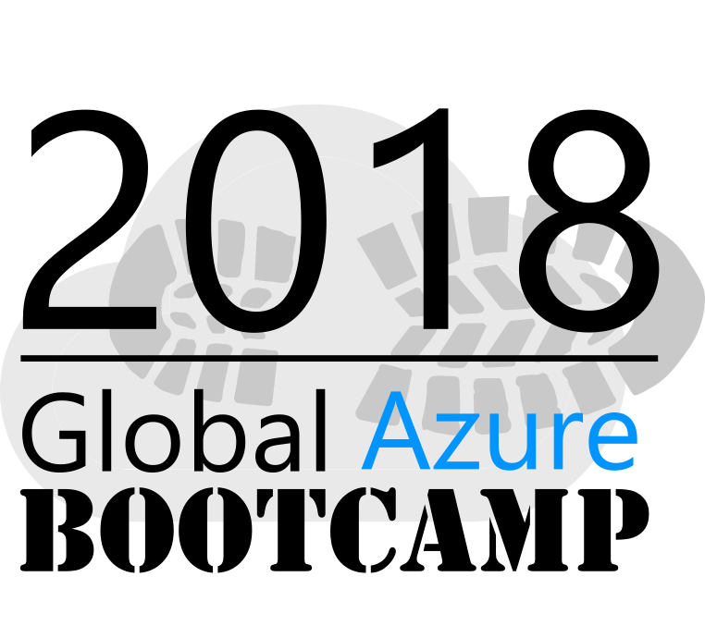
April 21, 2018 - Ogden, Utah

Slide 2
Welcome

Slide 3
Agenda
8:30-9:15 Welcome and Introduction to Azure Portal
9:15-10:00 Web Apps
10:00-10:45 Entity Framework (EF)
10:45-11:00 Break
11:00-11:45 Azure Database
11:45-12:30 Lunch
12:30-1:00 Azure Functions
1:00-2:00 Azure Application Insights
2:00-2:15 Break
2:15-3:00 Visual Studio Team Services (VSTS)
3:00-3:45 DevOps
3:45-4:30 Closing

Slide 4
Goal
Today we will focus on practice (20% theory, 80% practice).
Throughout the day, you'll build a web-based application running on Azure using several Azure services. Instructions and help will be provided.

Slide 5
Step 0 Introduction to Azure and the Azure Portal

Slide 6
Goal
Getting to know Azure and the Portal

Slide 8
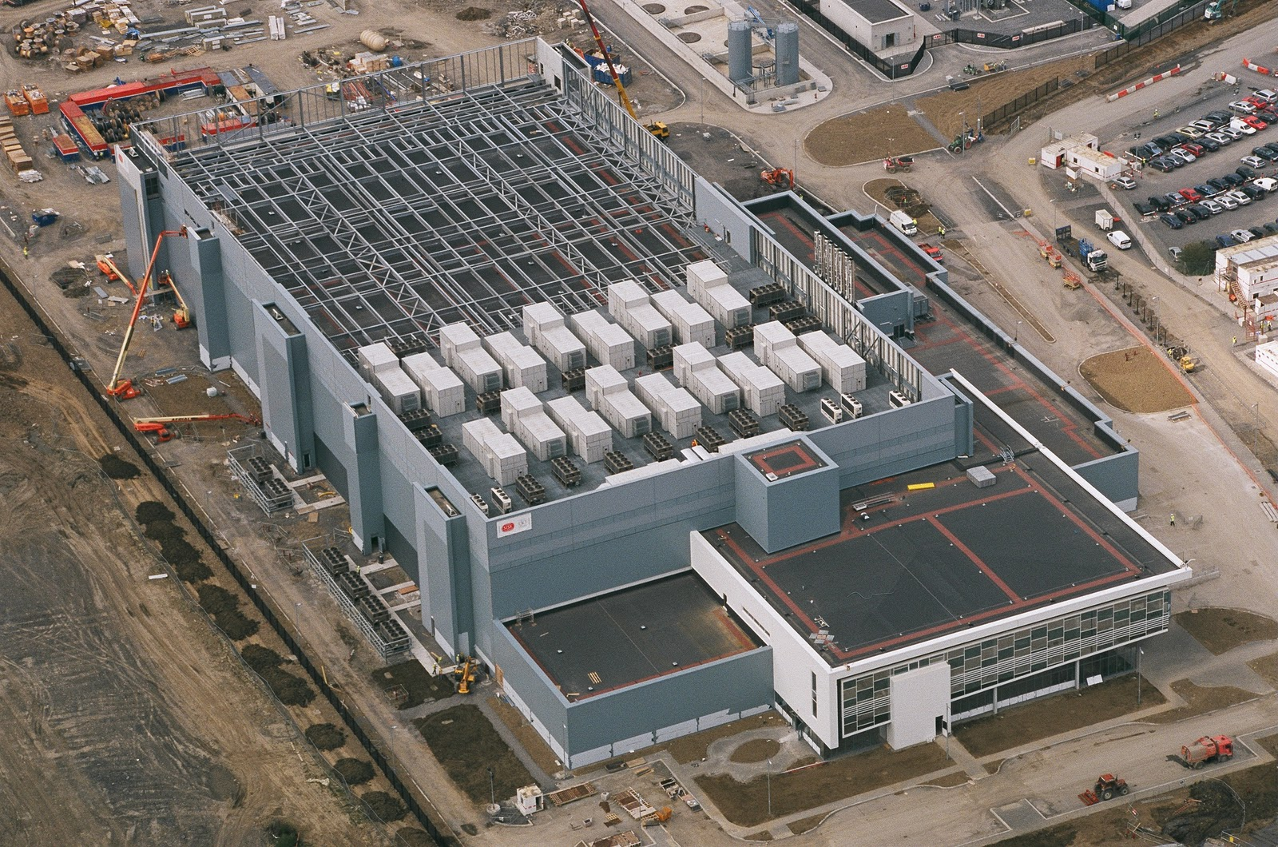
Notes:
This is what we think of when we hear the word “Datacenter”

Slide 10
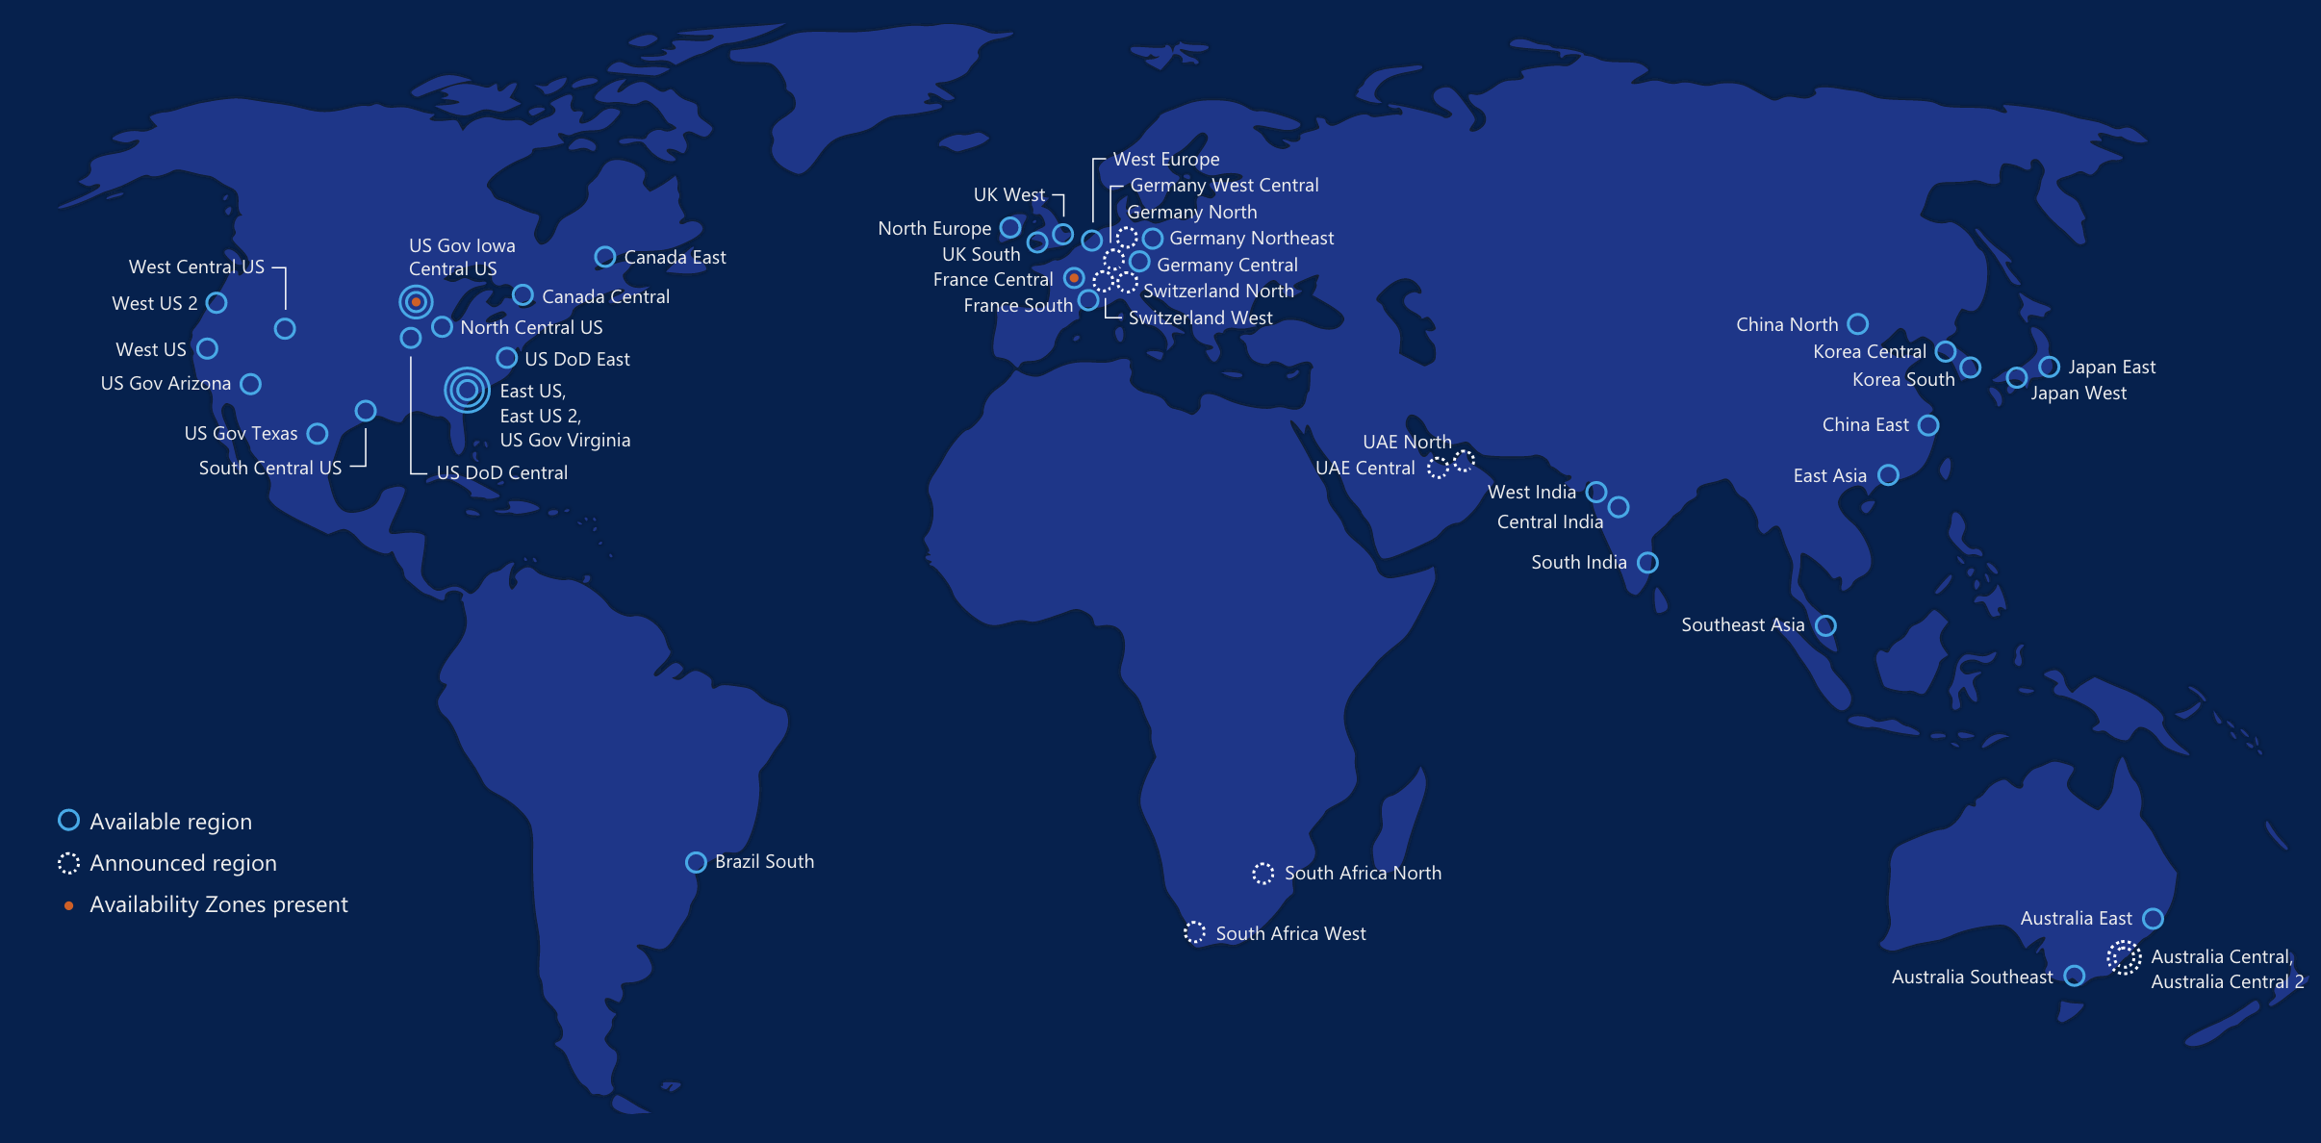
Achieve global scale, in local regions
50
Azure Regions
Notes:
At the core of Azure is its global infrastructure that spans 50 regions worldwide. We have the largest footprint of any cloud provider.
https://azure.microsoft.com/en-us/regions/
https://azure.microsoft.com/en-us/regions/services/

Slide 11
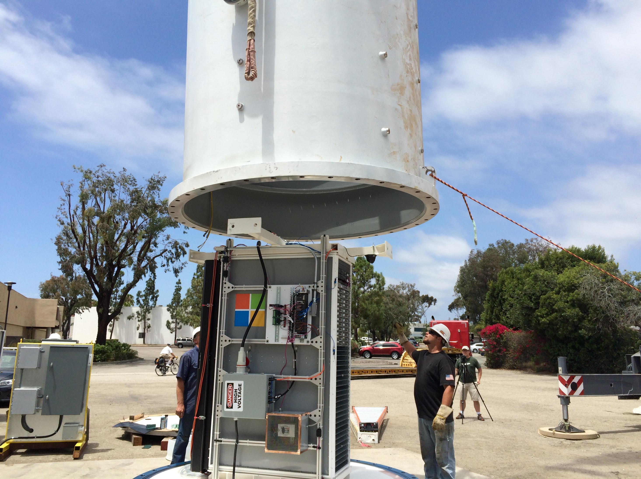
Notes:
My kids will probably hold a very different images of what a data center is. Microsoft Research is actively working on new approaches to bring resources online with more agility and proximity.

Slide 12
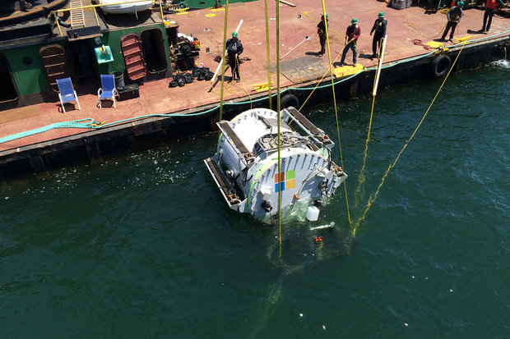
Notes:
Con’t

Slide 13

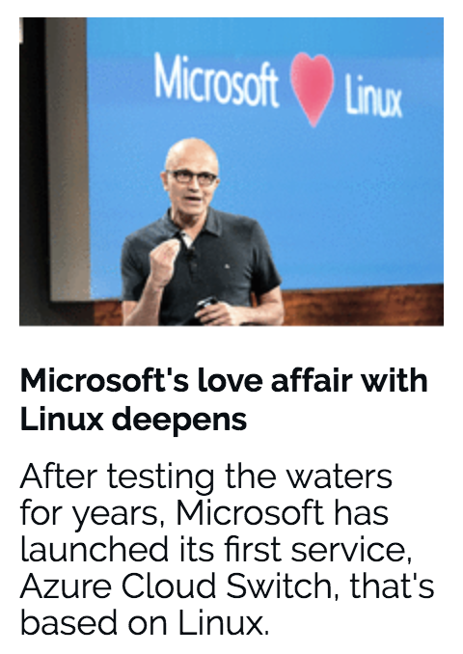
Notes:
Azure isn’t about Windows, its about enabling you to achieve more. Microsoft is undergoing a tremendous transformation and Linux/ Open Source Software is part of it. In a second we will dive in and I want you to remember that Microsoft is now the number contributor to OSS on GitHub and that some of the offered services are built and operated on Linux.
One of these services is the Azure SDN (Software Defined Network)
http://www.datacenterdynamics.com/content-tracks/servers-storage/microsoft-runs-azure-networking-on-linux/94837.fullarticle
Azure cloud uses Linux to handle data center networking - in a specialized software component developed by Microsoft to run conectivity within its cloud operating system, along lines set out by the Open Compute Project.

Slide 14
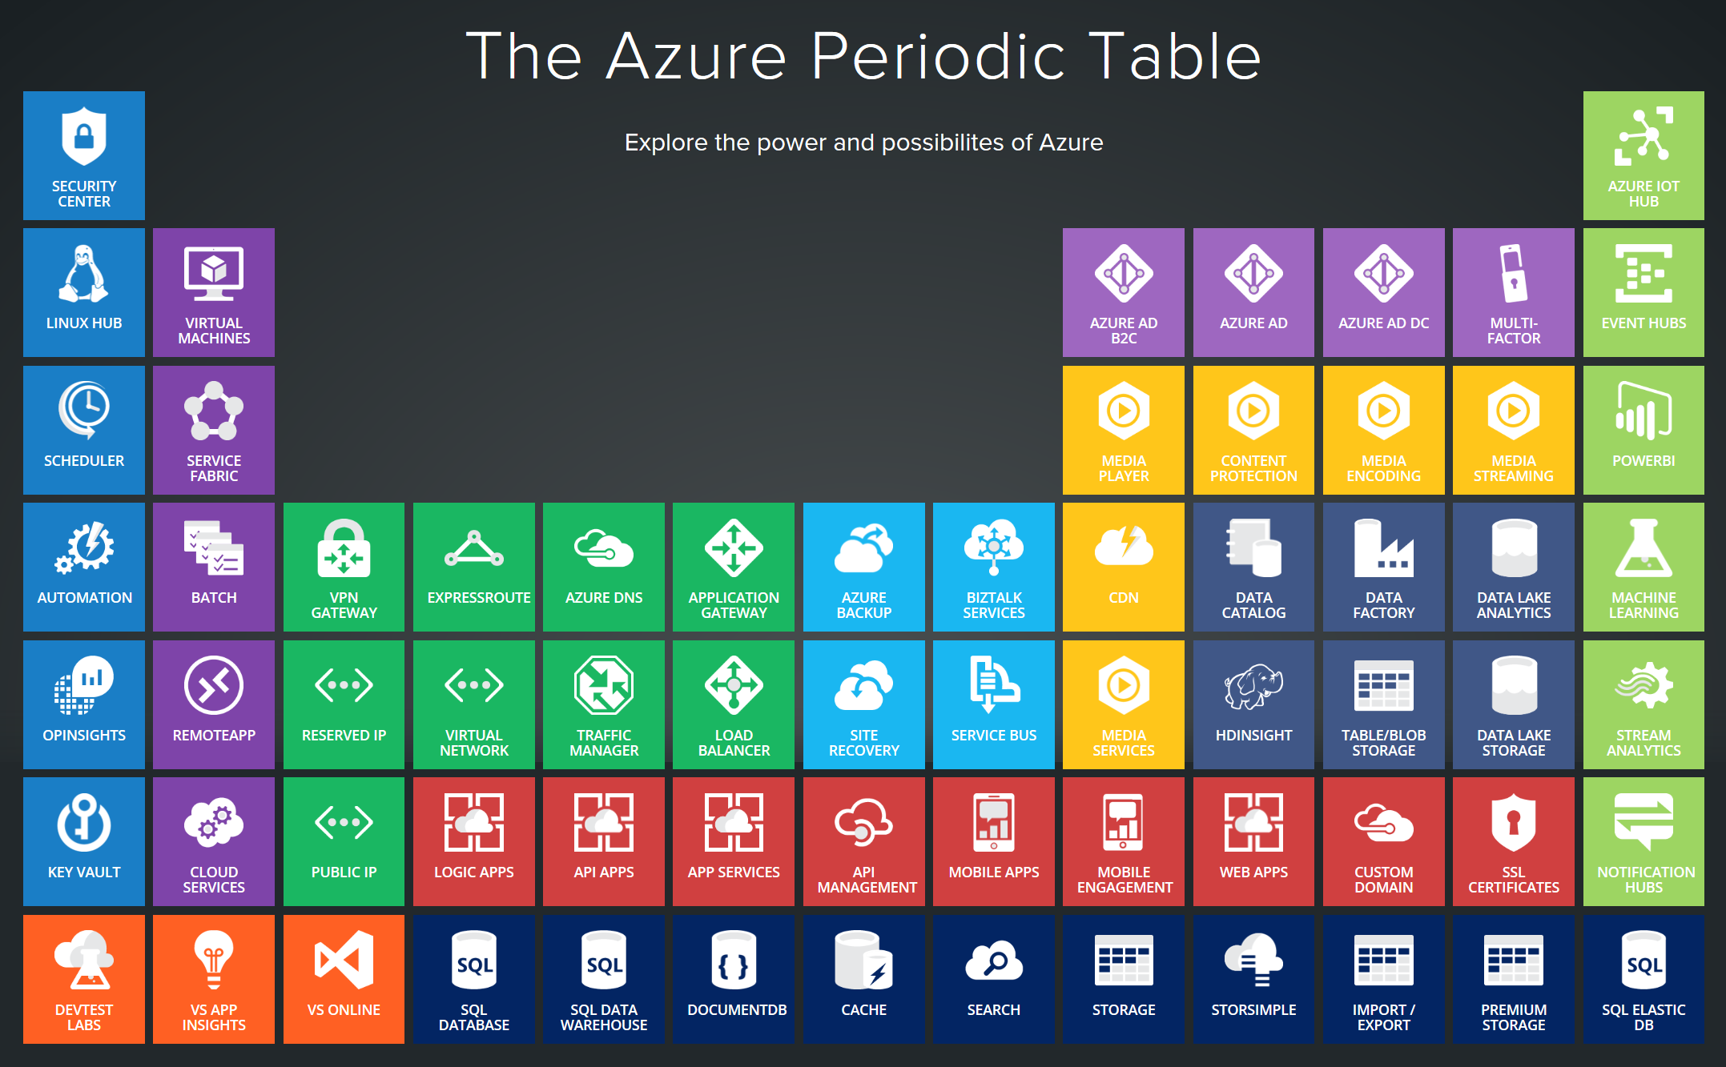
Notes:
Azure services support a multitude of scenarios from Infrastructure to platform services and extends your existing environments through various interconnectivity options. In today’s world, the level of sophistication required to innovate and compete requires us to be agile and adjust to a rapidly changing landscape. The cloud-only approach doesn’t work well for every scenario. Think about IoT and business critical workloads that drive delay sensitive manufacturing processes. Success comes from taking a hybrid approach and leveraging the cloud where it makes sense.

Slide 16
http://portal.azure.com
Notes:
Walk through the different sections, support tickets, azure market place, resource groups….

Slide 17
References:
Get started with Azure
Microsoft Azure Blog
Azure Updates
Cloud Platform roadmap
Azure Code Samples
Azure Quickstart Templates
AzureCAT Guidance
Cloud Design Patterns

